Slide 1
Using Learning Rate Schedules for Deep Learning Models
By Aymen Tariq

Slide 2
What is Learning Rate?
Learning rate control the rate at which the model is trained
A larger learning rate allows faster training of the model, but with sub-optimal values for the coefficients or weights
A smaller learning rate allows the model to learn at a slower rate with more optimal values of coefficient or weights

Slide 3
Learning Rate Schedule for Training Models
Adapting the learning rate of gradient descent algorithm can reduce the learning time and improve the performance
This controls the rate at which the weights are updated
This approach is called learning rate schedule
Simplest approach is to reduce the learning rate with time
There are 2 commonly used learning rate schedules
Reducing the learning rate using large drops at particular epochs
Reducing the learning rate slowly depending upon epoch

Slide 4

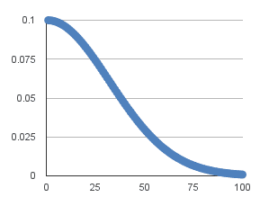
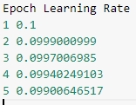
Time-Based Learning Rate Schedule
It is done through the “decay” argument in the SDG class
When you specify the decay argument, the learning rate will reduce from the previous epoch by the given fixed amount
Initially, if the earning rate is 0.1, then the decay is 0.001, the first five epoch will have the following learning rate

Slide 5
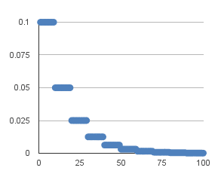
Drop-Based Learning Rate Schedule
This involves dropping the learning rate systematically at specific time during training
Often used by dropping the learning rate by half after a fixed number of epochs
Implemented using step_decay() function
Drop rate specifies the amount that the learning rate is updated each time it is changed e.g. 0.5
Let initial learning rate is 0.1
Epoch is the current epoch number
EpochDrop specifies how often the learning rate should be changed e.g. 10

